Slide 1
College Bazaar
Kelly Weber, James Moir, Patrick Isho, Trevor Drozd, Spenser Grzadzinski, Alissa Barnard

Slide 2
Sprint 6
Website Design
UX
Security
System fault testing
Quality assurance

Slide 3

Messaging completion. Updating UX

Slide 4
Contact Us

Slide 5
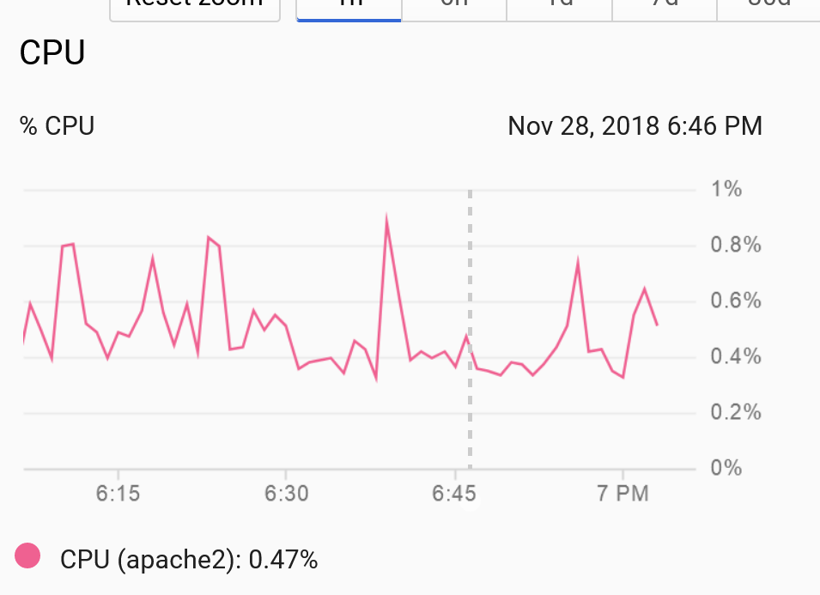
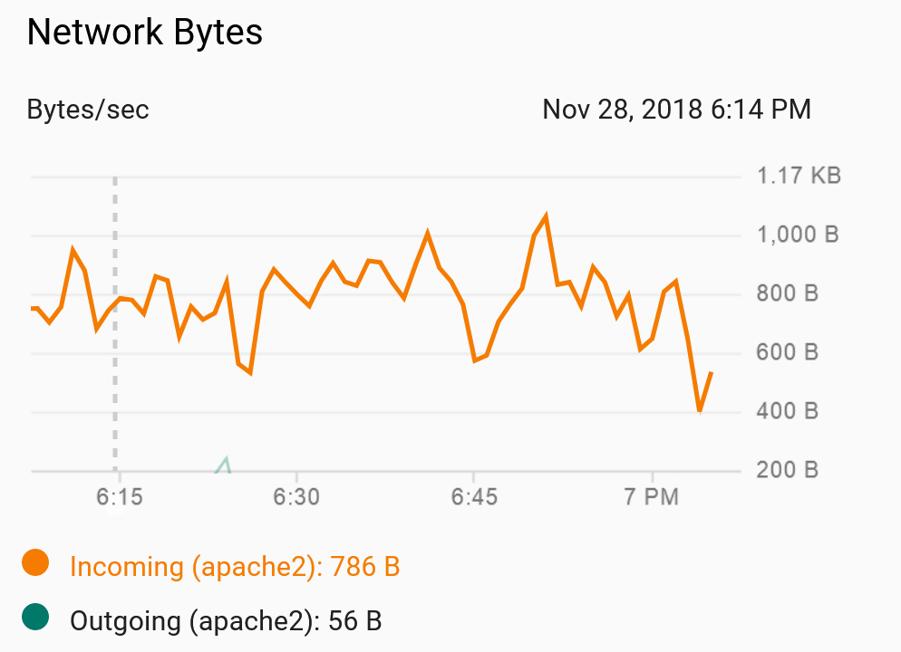
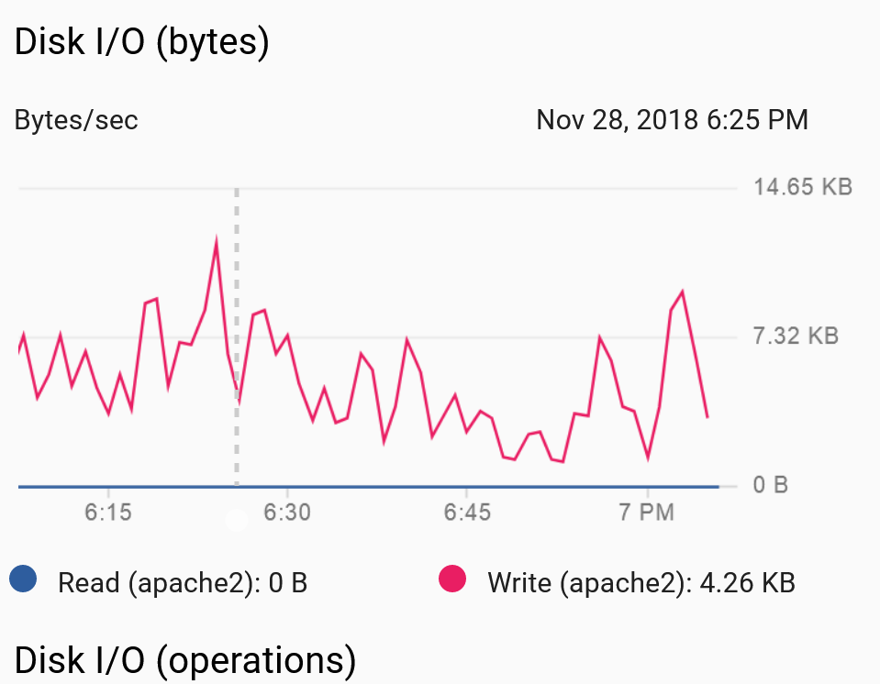
Fine Tuning Hardware
Used resources have been continuously monitored
Micro VM -> Small VM
1 CPU
1.1GB more RAM
New hardware needed after sql added
Current usage (6pm 11/29) to the left

Slide 6
Live Environment Integration
Code has been updated to meet live environment settings
DB connection
Links
Connection information

Slide 7
Live Testing
Server hosted pages testing has begun on the following:
Links
DB connection
Posting
Getting
Correct visuals
Proper implementation of Dev environment code

Slide 8
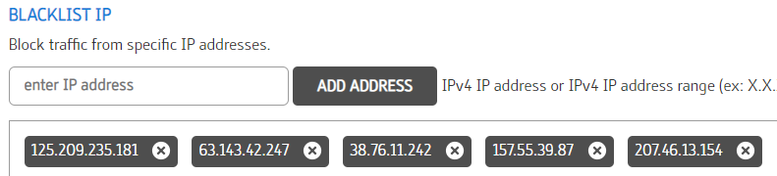
Security
Blacklists
Instantly block IPs
Good for known bad addresses
Dynamic list - feed based

Slide 9
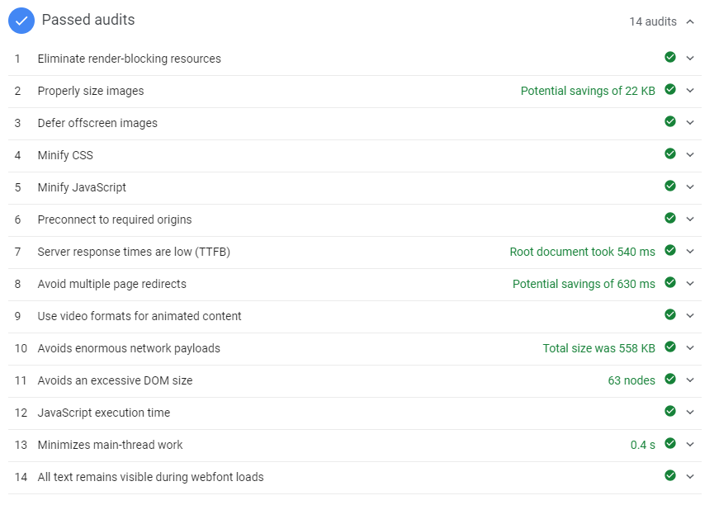
Security
Enforce WWW.
Less cookies (metadata)
Force HTTPS
Secure connection
https://developers.google.com/speed/pagespeed/insights/?url=collegebazaar.shop

Slide 10
Conclusion
UX design is clean and professional appearance
Completed functionality
Security tested
Live environment tested
Up next:
Final adjustments to website (polishing, clearing out “test” objects)
Final adjustments to database (polishing, clearing out “test” objects)
More system fault testing
Quality Assurance

